Slide 1



Toxics Release Inventory

Slide 2
What we will cover
Overview of the legal requirements
Pollution prevention for chemicals
Risk management and EMS
Financial reporting

Slide 3
Disclaimer
Information presented in this talk is meant to provide a starting point for understanding TRI. Guidance on the regulatory requirements is based on the latest information available.
The regulatory authority (EPA and/or TCEQ) ultimately determine compliance. Before reporting check your individual report against the current rules and policies.
This talk also discusses non-regulatory issues related to TRI, it is ultimately up to the company to decide how to apply the information (if at all).

Slide 4
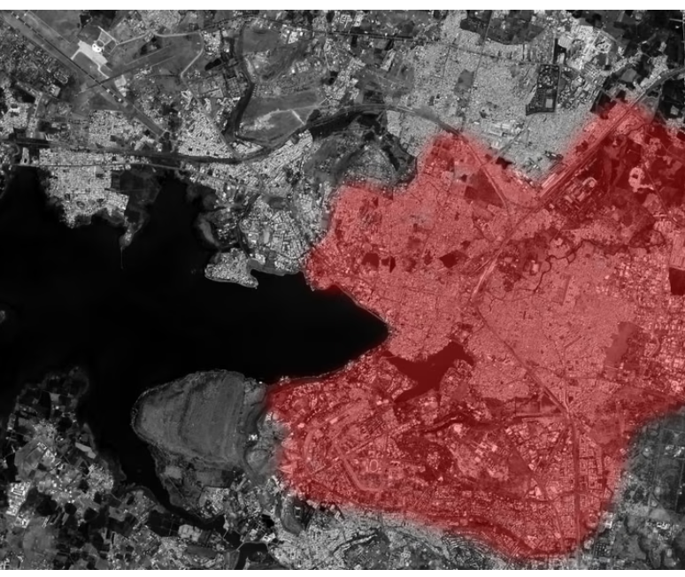
Background
Dec 4, 1984 my chemistry teacher explains a chemical plant disaster that happened that day.
3,000 – 8,000 dead immediately
15,000 to 25,000 over time
Similar release in West Virginia
No fatalities, but the plant had ongoing compliance issues.

Slide 5
Laws and their Acronyms
EPCRA - The Emergency Planning and Community Right-to-Know Act of 1986
SARA:Title III - Superfund Amendments and Reauthorization Act authorized EPCRA to help communities plan for chemical emergencies.
Right To Know (RTK)- requires industry to report on the storage, use, and releases of certain chemicals to federal, state, tribal, territorial, and/or local governments. It also requires these reports to be used to prepare for and protect their communities from potential risks.
TRI – Toxics Release Inventory a database of toxic chemicals.
https://www.epa.gov/epcra/what-epcra

Slide 6
TRI – The Toxics Release Inventory
Publicly accessible EPA database contains information on releases and transfers of over 799 toxic chemicals from more than 21,000 U.S. industrial facilities
Provides communities with information regarding toxic chemical releases and waste management activities
Supports informed decisions by industry, government, nongovernmental organizations, and the public.
Notes:
Bhopal, India (2,000+ fatalities) Dec 3, 1984
Institution, WV August, 1985

Slide 7
Multimedia Reporting
TRI is unique because it covers the individual chemical, not the media in which it is released/transferred.
Hazardous Waste may contain TRI chemicals but be reported in different quantities.
Hazardous waste tracks mixture weight
TRI only the chemical
Both serve different purposes

Slide 8
TRI Regulations
Superfund Amendment and Reauthorization
Act Title III, Section 313
Emergency Planning and Community Right to Know Act
TRI Rules - Title 40 Code of Federal Regulations Part 372
Texas Requirement: Texas Health and Safety Code, Chapter 370

Slide 9
Common Sectors Required to Report
Chemicals
Electric Utilities
Petroleum
Hazardous Waste/Solvent Recovery
Primary Metals
Paper
Food/Beverage/Tobacco
Fabricated Metals
Plastics and Rubber
Stone/Clay/Glass
40 CFR 372.23 Lists the NAICS CODES
https://www.epa.gov/toxics-release-inventory-tri-program/tri-covered-industry-sectors

Slide 10
Reported Chemicals
799 individual chemicals and 33 chemical categories
List changes as new data on toxicity emerges.
Some chemical and chemical categories are classified as Persistent Bioaccumulative Toxic (PBT) chemicals and have different reporting requirements.
Qualifiers are applied to some chemicals and chemical categories to account for physical forms
dust, fumes,
fibrous forms,
friable materials,
aerosols,
Etc.…
Notes:
Chemical category examples – arsenic, barium, cadmium compounds, chlorophenols, cyanide compounds, diisocyanates, dioxin and dioxin-like compouns, nicotine and salts, polybrominated biphenyls, polycyclic aromatic compounds, strychnine and salts
Qualifier examples – dust or fumes – aluminum and zinc; fibrous forms – aluminum oxide; friable – asbestos; aerosols – sulfuric and hydrochloric acid; allotropes – yellow or white phosphorus; manufacturing techniques – isopropyl alcohol by strong acid process or saccharin manufacture, not process or otherwise use; and geographical origins – chromium except chromite ore mined in the Transvaal Region of South Africa and the unreacted ore component of the chromite ore processing residue

Slide 11
TRI Reporting

Slide 12
Reporting Criteria
Three Criteria
10 or more full-time employees or 20,000 work hours;
NAICS Code listed – only some industries
Manufacture, process, or otherwise use more than the threshold amount for that classification of a TRI chemical.

Slide 13
Threshold Amounts
Like Hazardous waste, TRI is measured by weight. As a rough guide a TRI solvent will be approximately 300 gallons or five and a half drums.
For most TRI Chemicals
25,000 pounds manufactured
production,
preparation,
compounding, or
import
25,000 pounds processed (preparing a TRI chemical for distribution in commerce); or
10,000 pounds otherwise used

Slide 14
Lower Thresholds for PBT
For a facility to meet criteria requirements for PBT chemicals, manufacturing, processing, and otherwise use site-level totals must be at least:
100 lbs. for aldrin, lead, lead compounds, methoxychlor, polycyclic aromatic compounds, pendimethalin, tetrabromobisphenol A, and trifluralin;
10 lbs. for benzo(g,h,i)perylene, chlordane, heptachlor, hexachlorobenzene, isodrin, mercury, mercury compounds, octachlorostyrene, pentachlorobenzene, polychlorinated biphenyls, and toxaphene; or
0.1 grams for dioxin and dioxin-like compounds.

Slide 15
Reporting Process
Submit TRI reports to EPA using TRI-Meweb by July 1st
following the reporting year.
- Starts the WRPA deadline for newcomers
Each chemical must be reported using either Form A or
Form R..
When using TRI-Meweb, the submission is automatically
submitted to the Texas Commission on Environmental Quality
(TCEQ).
https://www.epa.gov/toxics-release-inventory-tri-program/electronic-submission-tri-reporting-forms

Slide 16
Form A vs. Form R Reporting
Form A – A shorter form. Reports facility information and the chemical name.
Does not trigger WRPA
Form R reports include facility information, and detailed information on release/transfer of chemicals
One Form R meets the threshold for WRPA

Slide 17
Form A Reporting Criteria
Less than 500 Pounds of TRI Chemicals:
released,
treated,
recovered, and/or
combusted
transferred

Slide 18
Form A Reporting Differences
PBT chemicals are ineligible for Form A reporting.
Using only Form A reports does not trigger the Waste Reduction Policy Act.
Lower/no reporting fees

Slide 19
Pollution Prevention and TRI

Slide 20
Lean and Chemical Use
Use of chemicals that don’t add value
Use of dangerous/polluting chemicals
Excess inventory – Disposal of chemicals
By-products
Notes:
Just as we look for time, consider what chemicals do to your bottom line

Slide 21
Processes with Chemical Waste
Bonding and sealing
Chemical and hazardous material management
Chemical manufacturing
Cleaning and Surface Preparation
Metal fabrication and machining
Metal finishing, plating and polishing
Coating
Welding
Chemical packaging
Notes:
Good slide to know …if you have these look closely

Slide 22
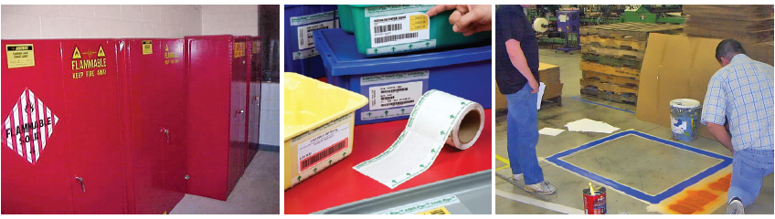
Visual Controls
Where to put the chemical
How much chemical to use
What is in a container
Where it is stored
Notes:
RCRA requires most of these, and they are examples of visual controls

Slide 23
Chemical Considerations
What types of chemicals are used at the facility?
What chemicals are produced?
How can we identify and mark chemicals?
What is the hazards of the chemicals?
What is the purchase cost?
What is the efficiency of use?
Who makes decisions involving chemical use/purchase at your company?
Notes:
Some questions to ask during a Lean event

Slide 24
Implementing Lean and Chemical Use
Right sized containers
Just in time chemical use
Target chemicals during Kaizen events
Notes:
Some general ideas

Slide 25
Underlying Causes and Chemicals
Determine why a hazardous chemical is used
Determine why a chemical is wasted.
The largest reductions in chemical use often started with a clear understanding of why the chemical was used.
Notes:
The following slides should be interactive

Slide 26
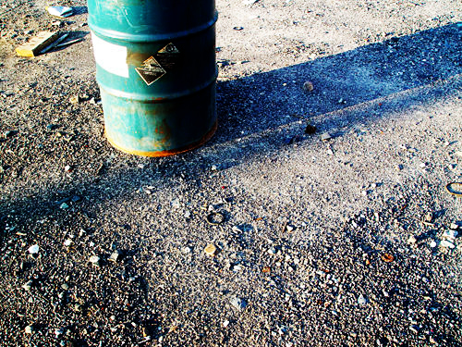
What questions do you ask?
Notes:
You see a barrel on the “back 40” what questions do you ask

Slide 27
Why is the (acid) Solvent a Waste?
Because it has oil
Notes:
Creative commons license – flikr “drp”
Prompt them to keep asking why

Slide 28

Why does the solvent have oil
We are removing it from the part

Slide 29
Why does the part have oil
The manufacturer puts it on
Why does the manufacturer put oil on it
To prevent Corrosion

Slide 30
Why is this type of corrosion protection needed?
We don’t know any other ways to protect the parts from corrosion. Let’s form a team to identify and test some alternatives.

Slide 31
Underlying Cause
The company wants a product that has no corrosion
The oil and solvent do not add value to the process
So an underlying cause is corrosion protection
Form a team and look at alternatives
Some underlying causes are easier to address than others.
Keep looking for causes and solutions.

Slide 32
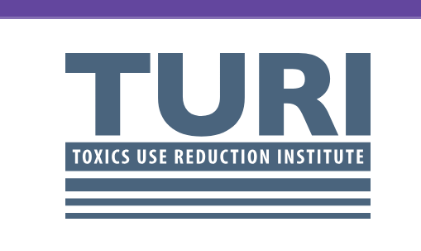
Alternatives to Solvents
https://www.turi.org/tools/
Cleaner Solution database
P2 Options Assessment

Slide 33
TRI, Risk Management and Financial Ratings
Bhopal business loss
$400 million settlement
Forced to sell most profitable lines
Hostile takeover
Investments lost value
Investors increasingly seek assurance
ISO and Risk management systems
Financial disclosures
Notes:
What can you do to win your managers commitment. A lot of this comes from what we’ve notice working w/ many companies. Reduce Risk Reduce Liability Reduce Time needed for Market Reaction Increase Compliance Increase Public Perception. Show them the benefits that can be achieved through P2 planning.

Slide 34
Types of Audits
Regulatory – government/company inspections for compliance
Operational – Has a set scope of duties and aligns a team for maximum productivity.
ISO
Regulatory Compliance
Financial Audits
We have seen an uptick in environmental evaluation from long term investors, portfolio managers and other financial management issues.

Slide 35
Annex SL – Multiple Standards
ANNEX SL
ISO 14001 Environmental Management System
ISO/IEC 27001 Information Services
TS 16949 Automotive
ISO 22301Business Continuity
ISO 45001 Health and Safety
ISO 9001 Quality Management System
TRI Chemicals
Will come up in both these standards
TRI Chemicals
Might come up in any audit of Annex SL standards

Slide 36
Financial Reporting and Right to Know
“Laying the foundation for all the stakeholders is key. You can’t build trust when a crisis happens. You build trust before a crisis happens.” – Scott Keller
“Impacting audiences across the globe: CEO Excellence revisited”
(https://www.mckinsey.com/featured-insights/mckinsey-on-books/impacting-audiences-across-the-globe-ceo-excellence-revisited)

Slide 37

Global Reporting Initiative (GRI)
An international independent standards organization that helps businesses, governments and other organizations understand and communicate their impacts on issues such as climate change, human rights and corruption.
www.globalreporting.org
Notes:
https://en.wikipedia.org/wiki/Global_Reporting_Initiative

Slide 38
GRI Standards
Widely accepted standards
Free*
Sponsored by financial sector donations
*Conditional use
Covers three areas
Environmental
Economic
Social
Notes:
Ultimately reporting that lines up with GRRI standards will have a larger degree of trust and credibility than standards developed in house.

Slide 39
GRI Support
A network of many thousands worldwide
create the reporting framework,
use it in disclosing their sustainability performance,
demand its use by organizations
working to improve it

Slide 40
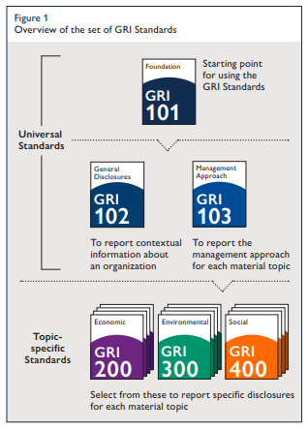
GRI Standards: Structure
101: Foundation for using
Universal Standards
102 Organization information
103 Management approach for each material topic
Topic Specific standards
Notes:
This is based off the 2016 GRI 101 revision. Encourage them to look on-line and get the latest standards.

Slide 41
GRI Financial Reporting Standard: Required Content
• Stakeholders
• Context
• Materiality
• Completeness
Stakeholder was the first step in determining which parts of the GRI apply.
Notes:
GRI emphasizes stakeholders IIt lays out specific things that have to be addressed (mandatory) for the report to be complete.

Slide 42
Stakeholder consideration in Financial Reporting
Stakeholders are defined as entities or individuals that can reasonably be expected to be significantly affected by the reporting organization’s activities, products, or
services;
or
Notes:
The first part deals with core customers and stakeholders

Slide 43
Stakeholders in Financial Reporting
…or whose actions can reasonably be expected to affect the ability of the organization to implement its
strategies or achieve its objectives.
This group is usually included in ISO Scope.
Notes:
This second group is people who can have an impact on the business. Often the same.

Slide 44
Affected by Stakeholder
The TRI reports are viewed and used by these groups.
How would we reach them? What additional information could supply context?
Affected by the organization's activities
vulnerable groups,
local
communities, and NGOs or other civil society
organizations, among others.
Notes:
These are some of the groups that get affected by the organization. Of course both of these are not necessarily one or the other.

Slide 45
Stakeholder Consideration in Financial Reporting
Affect the ability to implement objectives
Employees
Contractors
On-site external companies
Other workers
shareholders,
suppliers,
How is TRI impacting the views and actions of these groups.?

Slide 46
Stakeholders in Financial Reporting
Report content shall consider the reasonable expectations and interests of stakeholders.
This clause ties your company's performance to a broad range of people.
Ultimately the stakeholders will guide what is collected and how it is presented.

Slide 47
Russell 1000 (includes S&P 500) Sustainability in Financial disclosures
93% Published a report
90% Jump in 2022
GRI
54%
SASB
81%
SOURCE: G&A Institute 2024 study
SDGs
56%
TCFD
60%
Notes:
https://www.ga-institute.com/storage/press-releases/article/ga-institutes-research-shows-2023-sustainability-reporting-at-record-levels-as-us-public-compani/

Slide 48
Determining What’s Important
Significant Impact – ISO Operational
Guided by risk
Material – GRI Reporting
Guided by stakeholders
Investors
Public
Legal risk of misrepresentation
Obligation to investors to “walk the talk”

Slide 49
Following the standard for environment
Ensures a system that applies modern management techniques to environmental issues
…and leads to integration of the environment
in the mainstream business plan
…and integrates environment into every
aspect of operations and level of
organization--ownership

Slide 50
Standard
2. something established by authority, custom, or general consent as a model or example : _____quite slow by today's standards
3. something set up and established by authority as a rule for the measure of quantity, weight, extent, value, or quality
Source: Merriam Webster
Notes:
So a standard is just a value to measure against.

Slide 51
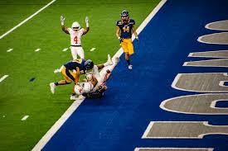

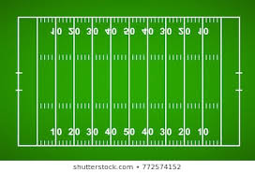
EMS is Not ISO
ISO is a standard to measure the performance of a management system
Standard
Checking Against a Standard
PERFORMANCE
Notes:
ISO is by far the most popular EMS standard. But a standard is not the actual thing that is measured. That would like thinking a yardstick is a football field. Once you have a system you have a playing field to perform upon. You can see when you are doing better, worse and see how other teams perform. You can learn and improve.

Slide 52
Performance
Controls risk
Maintains compliance
Reduces environmental impacts
Forwards the mission
Increase profits
Other purposes – e.g. improve healthcare quality for a hospital or readiness for a military unit.

Slide 53
Ratings for Investors
Various ratings agencies have methods for assessing environmental risk
Different investors use the data to make decisions
Long term investors with large portfolios tend to look at multiple metrics and methods.
Rapid rise in interest lead to EHS officers getting checklists that were different from their usual (compliance) lists.

Slide 54

Vinsights: When Standards are Counterproductive
Failure to understand why the standard exists.
Gaming the system
Measure only what makes for a good CSR report
Supply metrics to an “expert” without considering materiality.
Having and external “expert” work independent of the business.

Slide 55
It is up to the Business (mostly)
Regulatory compliance is non-optional,. They detail what should or should not be reported and how some issues are handled.
Financial and operational reports are often driven by the overall strategy of the company. Customers and investors may request information, but ultimately it is up to the company to decide on a response.
ISO – How far do you want to go to meet the standard?
Financial disclosures – Which issues you emphasize for action or change.

Slide 56
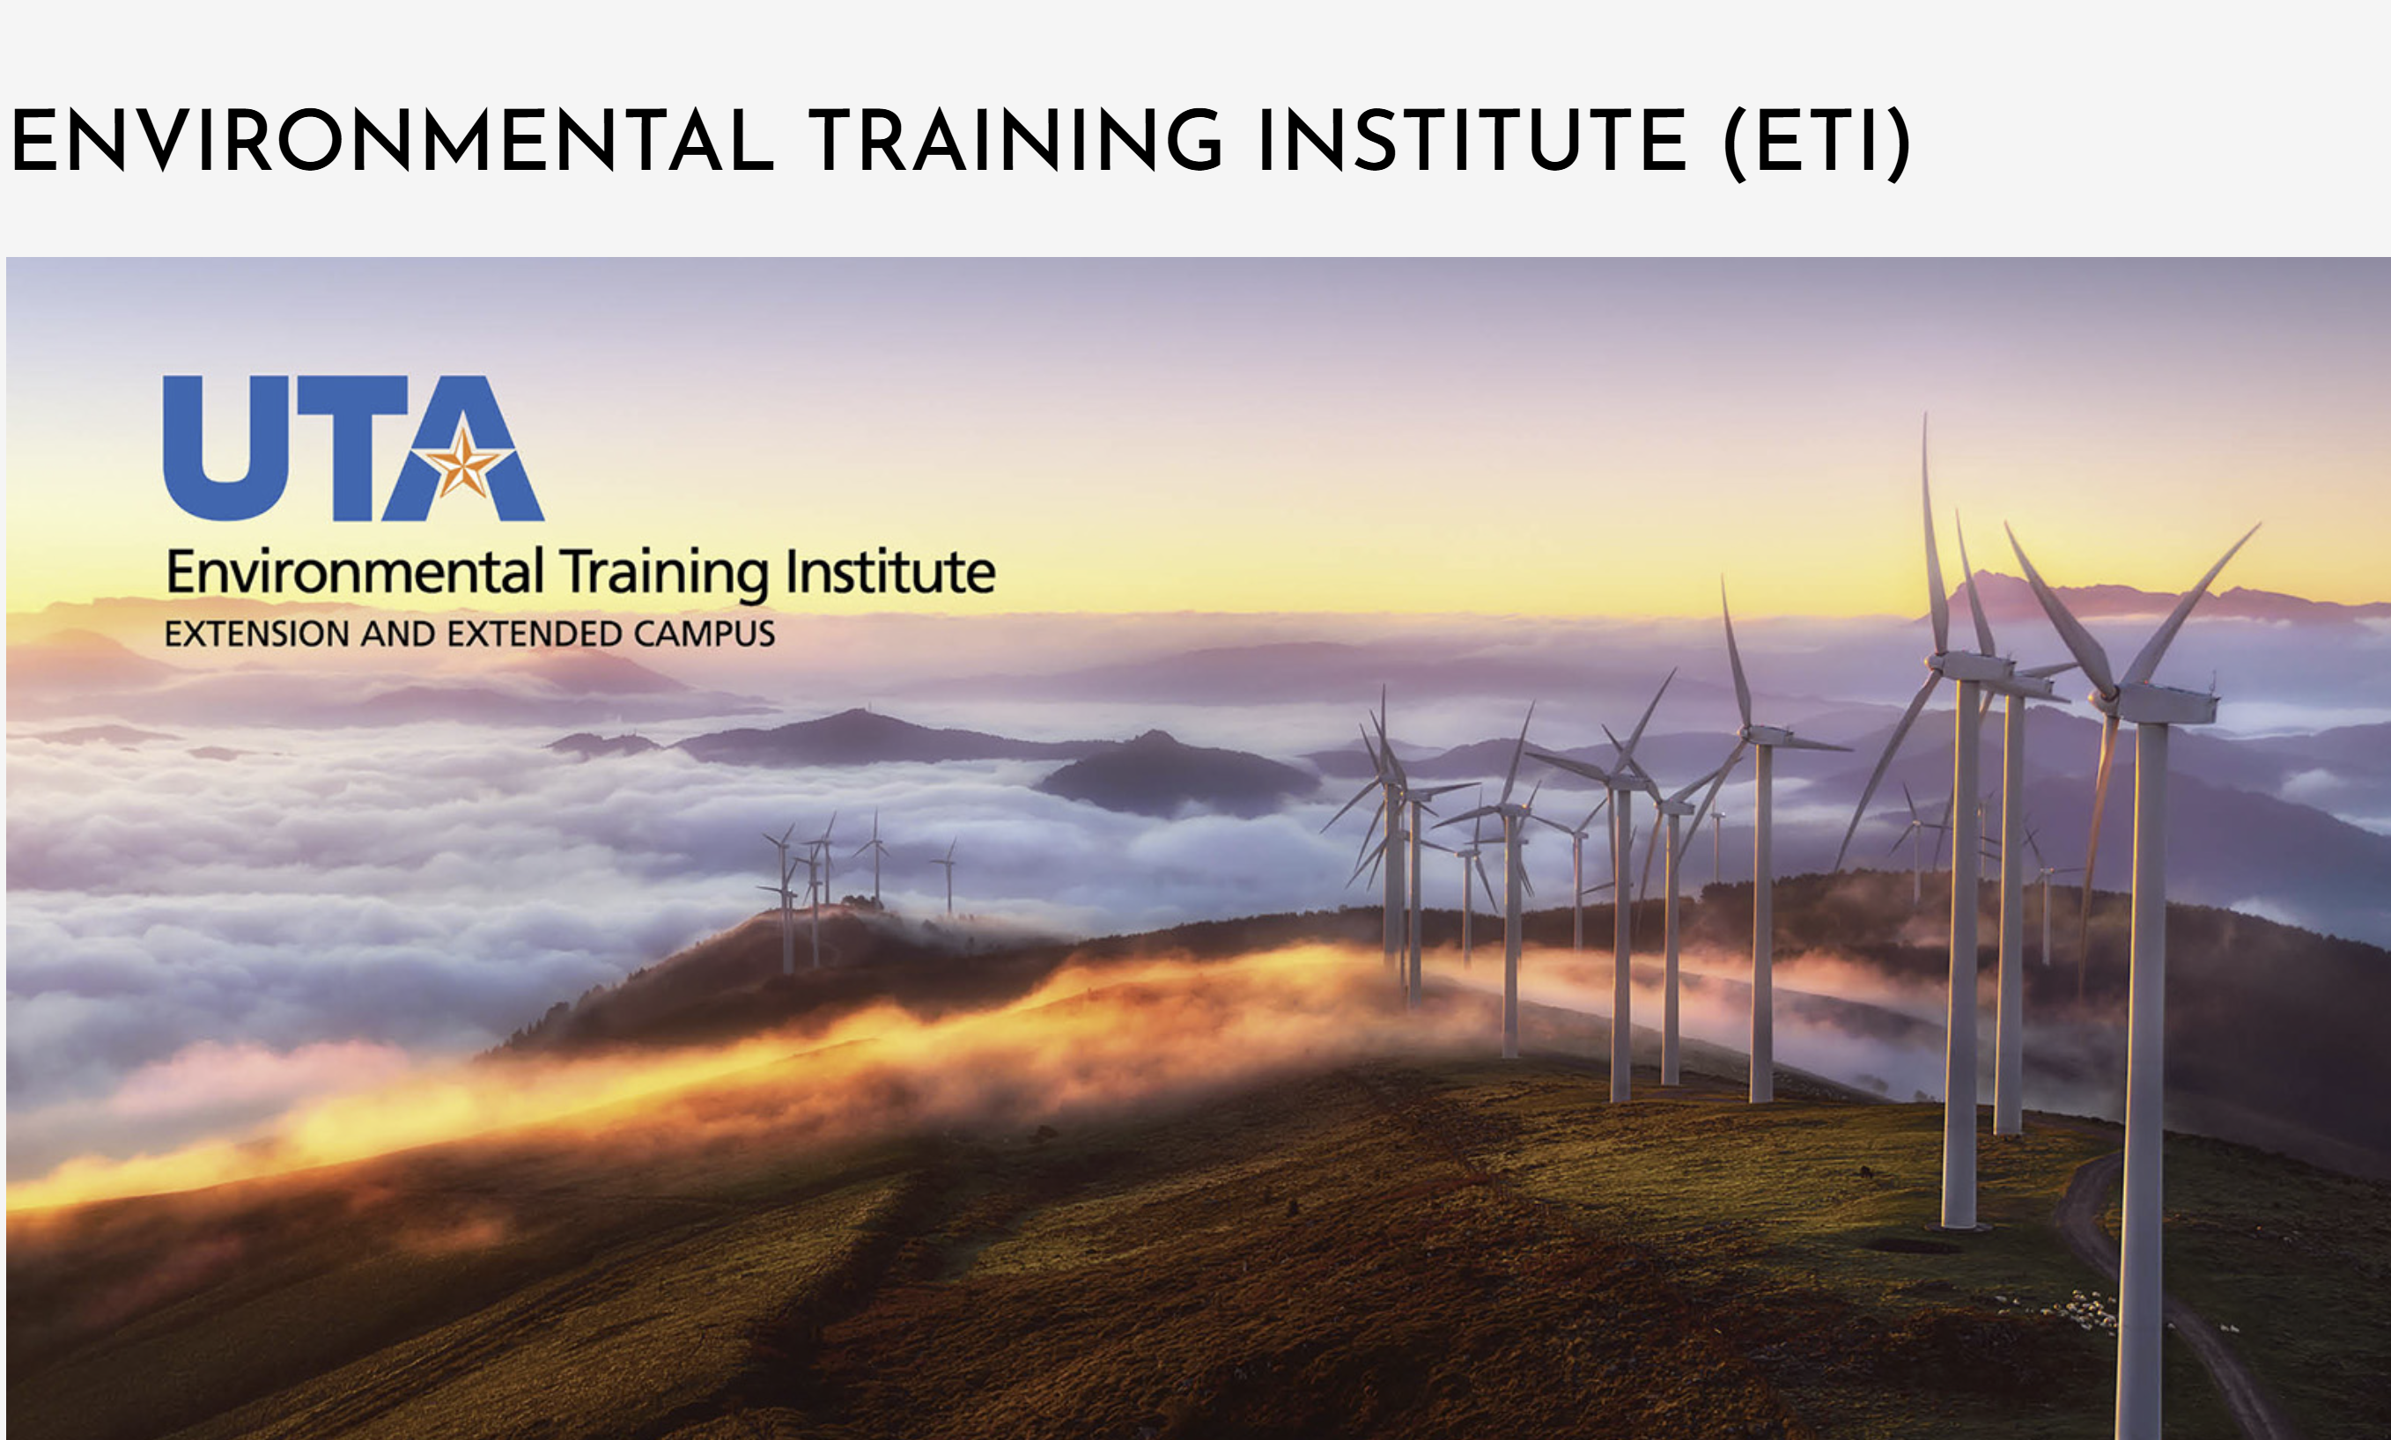
Related UTA Environmental Training
Toxics Release Inventory Reporting (2 day)
Environmental Management Systems (4 Days)
Financial Reporting ETI Sustainability Certification
Strategies in Sustainability (2 days)
Sustainability Workshop (4 days – over 4 weeks) – Advanced course
ETI 101- Introduction to Environmental Compliance (4 days)
MGE 810 – Environmental Auditing (3 days)
Pollution Prevention and Sustainability – (2 days)

Slide 57
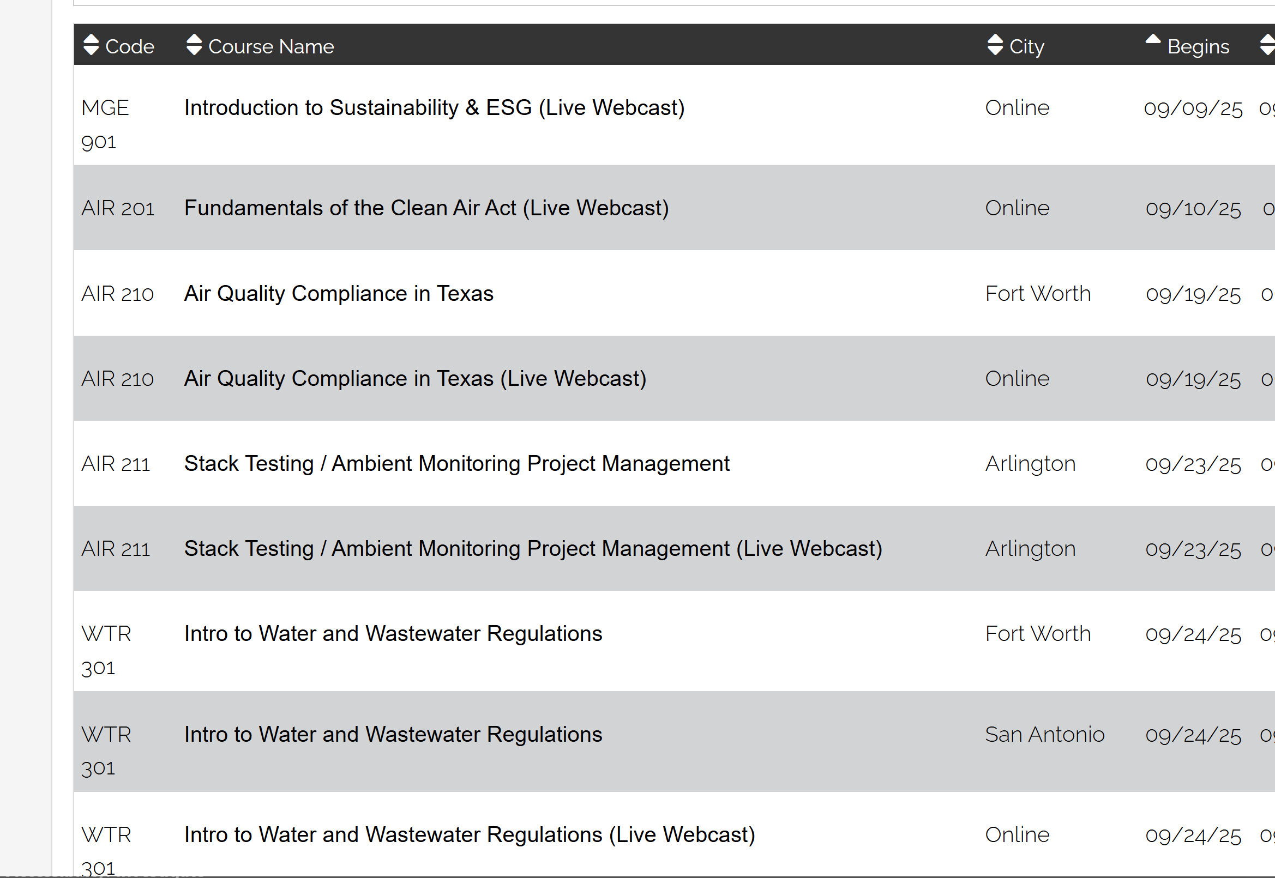
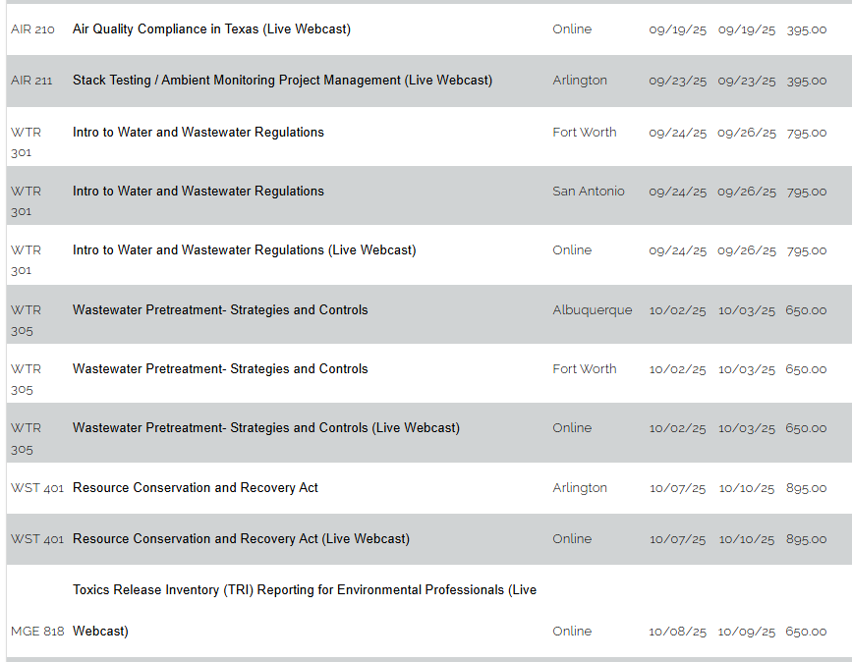
Giving professionals the ability to manage complex environmental issues.

Slide 58
Contact Information
EPA Region 6 Enforcement Coordinator
Office: (214) 665-8042 Email: Acosta.Gerardo@epa.gov
EPA GuideME: Screening tools and help
https://guideme.epa.gov/ords/guideme_ext/f?p=guideme:home
Central Data Exchange
https://cdx.epa.gov/contact
TCEQ TRI Helpline
(512) 239 - 4TRI {4874}
EPA TRI home page
http://www.epa.gov/tri/index.htm

Slide 59
Summary
TRI requires some industries to report their use and disposition of certain toxic chemicals
Pollution prevention can eliminate or reduce risks from these chemicals
TRI reports are a good source of data for consideration in risk management
Investors are seeking more financial data to guide their investments.

